Slide 1
How Much of the Internet Is Fake? Turns out a Lot, Actually.
Original Article BY: Max Read, New York Magazine, 2018
Presented By: Matthew Stevenson
CS895 – Spring 2019
Source: http://nymag.com/intelligencer/2018/12/how-much-of-the-internet-is-fake.html

Slide 2
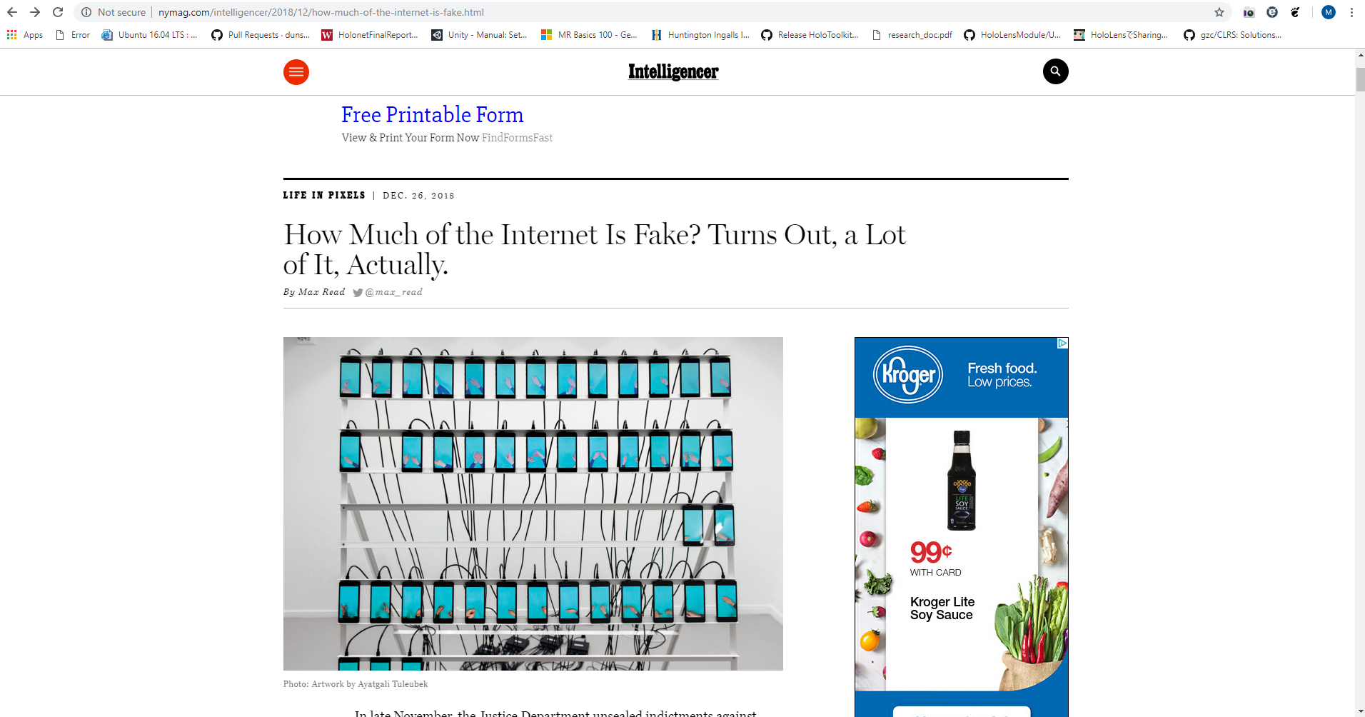
Source: http://nymag.com/intelligencer/2018/12/how-much-of-the-internet-is-fake.html

Slide 3
“Studies generally suggest that, year after year, less than 60 percent of web traffic is human; some years, according to some researchers, a healthy majority of it is bot.”
- Intellegencer

Slide 4
Is the Internet only BotNets?
In late 2018, Digital ad fraud was recorded by the Justice Department in excess of $36 million dollars of damages due to 3ve technology and Methbot as the culprets.
Traffic was spoofed to appear that websites running ads were receiving “real” data.
The type of traffic includes:
Fake clicks
Mouse movements
Social network login information appear to be a real user
Source: http://nymag.com/intelligencer/2018/12/how-much-of-the-internet-is-fake.html

Slide 5
3ve Technology

Slide 6
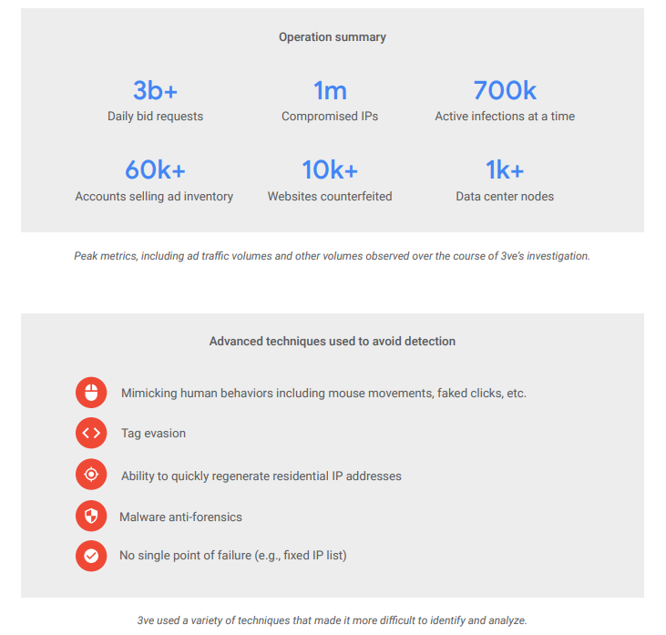
Effects of 3ve

Slide 7
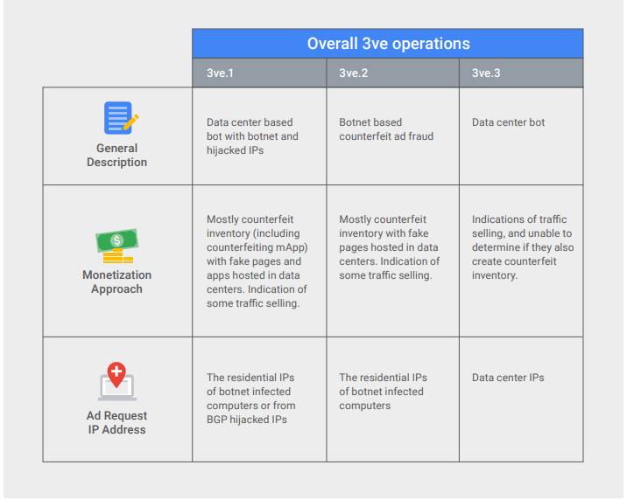
Source: https://services.google.com/fh/files/blogs/3ve_google_whiteops_whitepaper_final_nov_2018.pdf

Slide 8
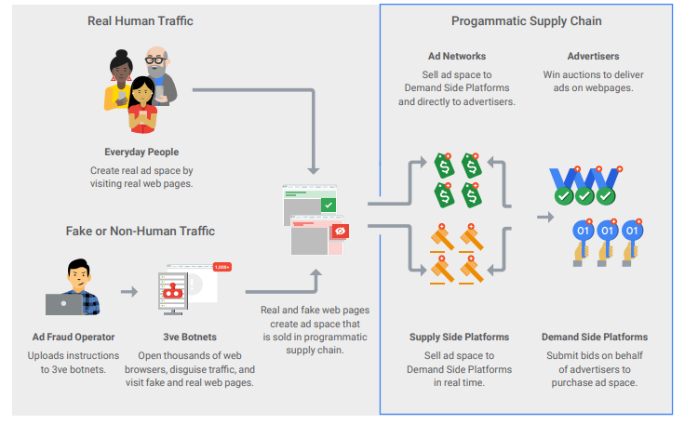
Source: https://services.google.com/fh/files/blogs/3ve_google_whiteops_whitepaper_final_nov_2018.pdf

Slide 9
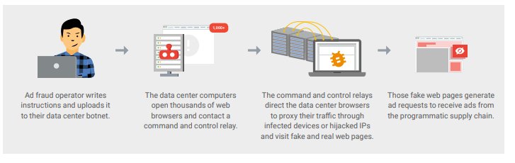
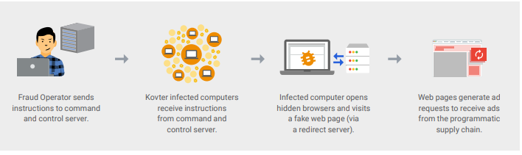
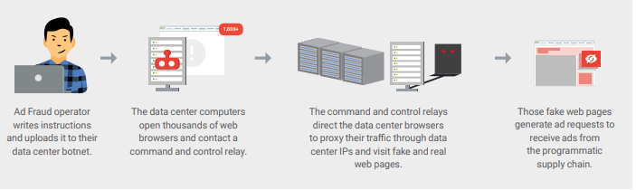
3v1
3v2
3v3
Source: https://services.google.com/fh/files/blogs/3ve_google_whiteops_whitepaper_final_nov_2018.pdf

Slide 10
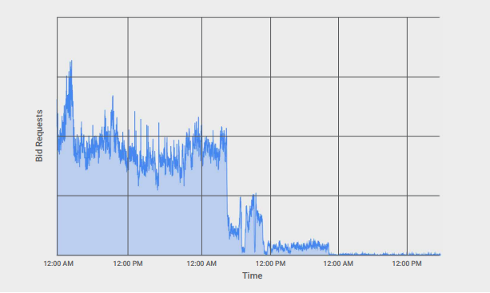
Source: https://services.google.com/fh/files/blogs/3ve_google_whiteops_whitepaper_final_nov_2018.pdf

Slide 11
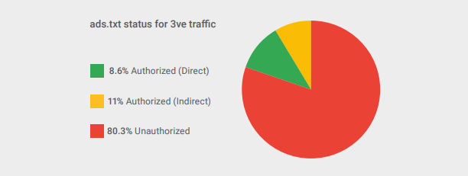
Source: https://services.google.com/fh/files/blogs/3ve_google_whiteops_whitepaper_final_nov_2018.pdf

Slide 12
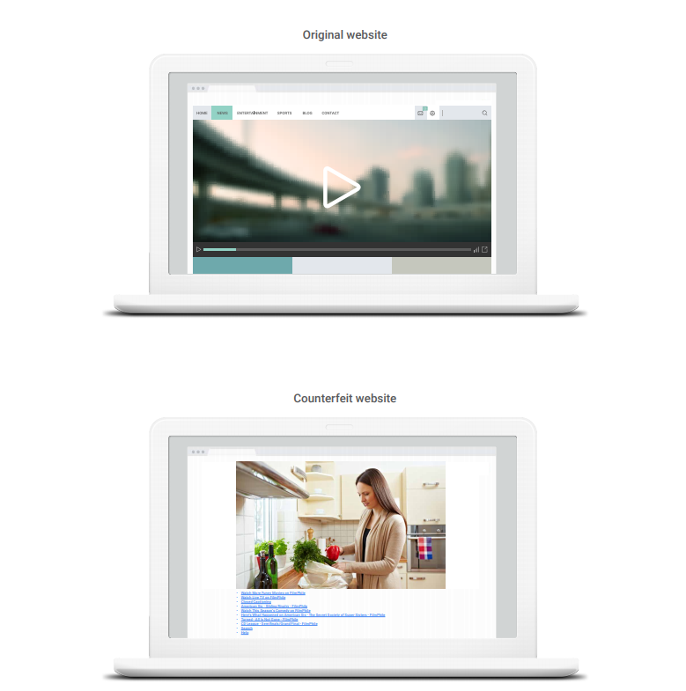
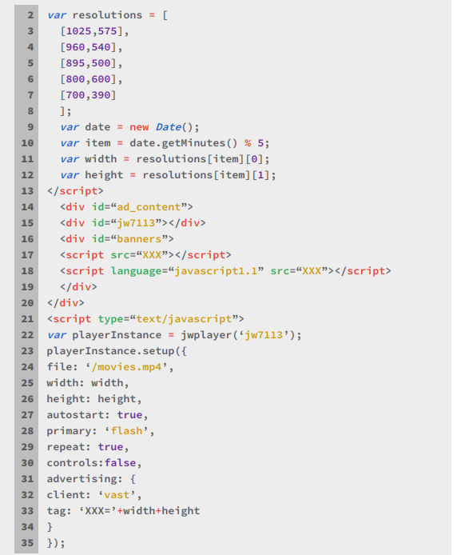
Fake website?
Source: https://services.google.com/fh/files/blogs/3ve_google_whiteops_whitepaper_final_nov_2018.pdf

Slide 13
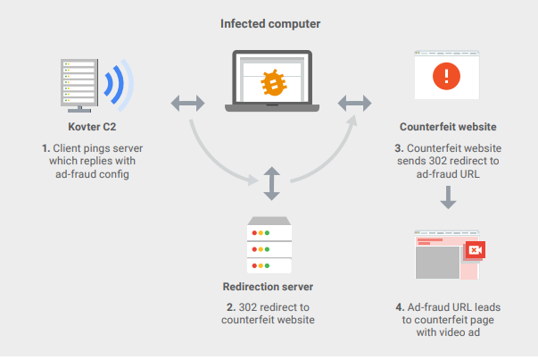
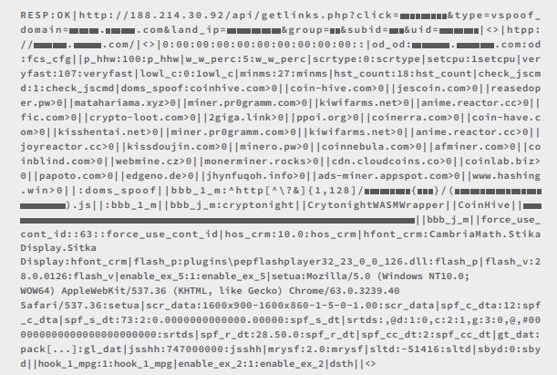
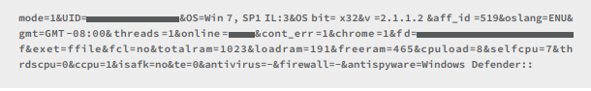
3v2 infected computer operations
Source: https://services.google.com/fh/files/blogs/3ve_google_whiteops_whitepaper_final_nov_2018.pdf

Slide 14
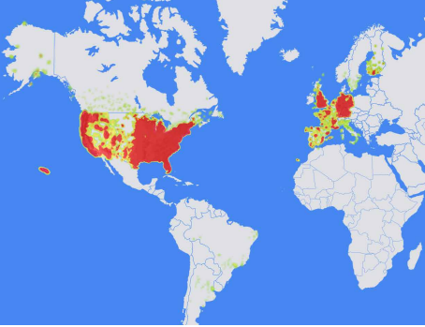
Area of infiltration for 3v2
Source: https://services.google.com/fh/files/blogs/3ve_google_whiteops_whitepaper_final_nov_2018.pdf

Slide 15
Methbot

Slide 16
Effects of Methbot
Source: https://cdn2.hubspot.net/hubfs/3400937/WO_Methbot_Operation_WP_01.pdf?__hstc=&__hssc=&hsCtaTracking=9c93c640-c638-4e10-8709-1f8e15d8c345%7C6338de37-adf9-48ea-b44a-a243fbd1685d

Slide 17
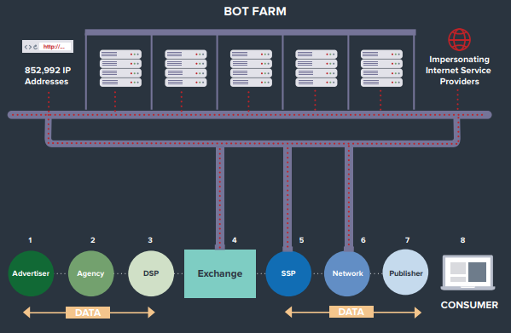
The Methbot Bot Farm
Source: https://cdn2.hubspot.net/hubfs/3400937/WO_Methbot_Operation_WP_01.pdf?__hstc=&__hssc=&hsCtaTracking=9c93c640-c638-4e10-8709-1f8e15d8c345%7C6338de37-adf9-48ea-b44a-a243fbd1685d

Slide 18
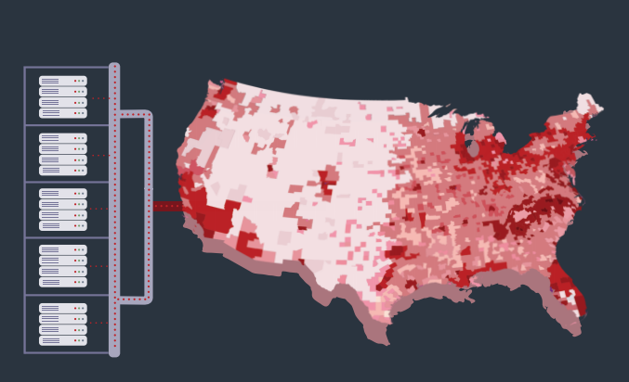
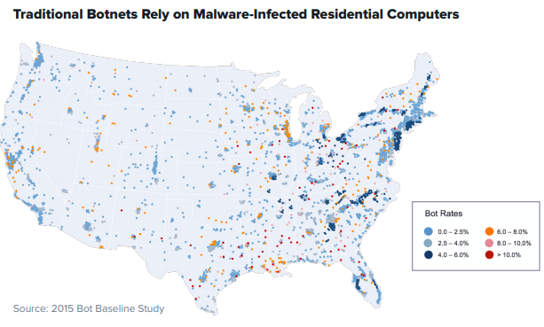
Heatmap Distribution of Methbot in Comparison to traditional Botnets
Source: https://cdn2.hubspot.net/hubfs/3400937/WO_Methbot_Operation_WP_01.pdf?__hstc=&__hssc=&hsCtaTracking=9c93c640-c638-4e10-8709-1f8e15d8c345%7C6338de37-adf9-48ea-b44a-a243fbd1685d

Slide 19

Characteristics of Methbot
Preserve session data between executions
Parse html
Uses JWPlayer to run ad tags and request video advertisements
NodeJS

Slide 20
Key Behaviors
Counterfeit pages
Offer Inventory
Produce Fake views and clicks
Source: https://cdn2.hubspot.net/hubfs/3400937/WO_Methbot_Operation_WP_01.pdf?__hstc=&__hssc=&hsCtaTracking=9c93c640-c638-4e10-8709-1f8e15d8c345%7C6338de37-adf9-48ea-b44a-a243fbd1685d

Slide 21
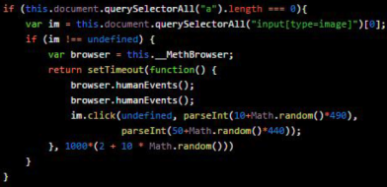
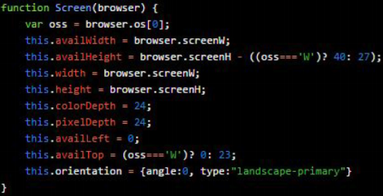
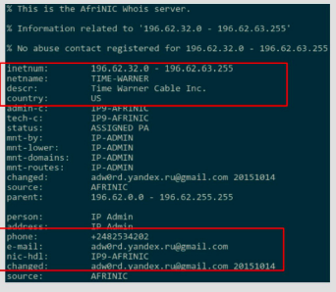
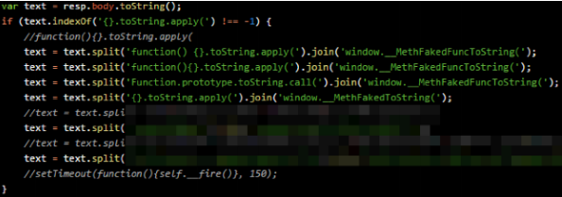
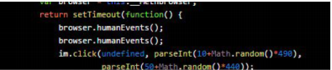
Avoidance of Fraud Detection
Screen object construction
Dynamic Code Patching
Spoofing Behaviors
Human Input Simulation
Forged IP Registration
Source: https://cdn2.hubspot.net/hubfs/3400937/WO_Methbot_Operation_WP_01.pdf?__hstc=&__hssc=&hsCtaTracking=9c93c640-c638-4e10-8709-1f8e15d8c345%7C6338de37-adf9-48ea-b44a-a243fbd1685d

Slide 22
Why Should We Be Concerned?

Slide 23
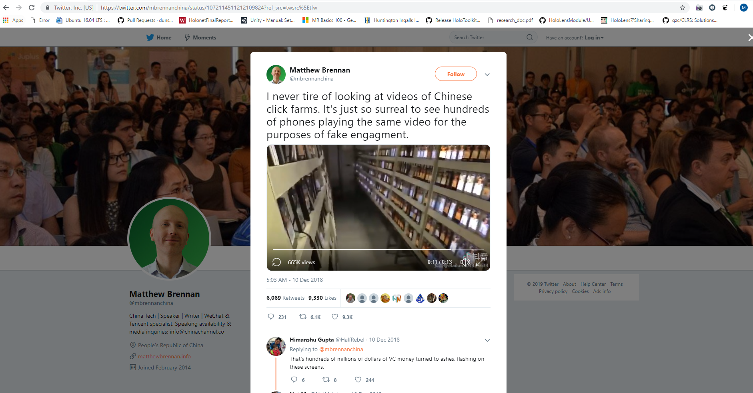
Source: https://twitter.com/mbrennanchina/status/1072114511212109824?ref_src=twsrc%5Etfw

Slide 24
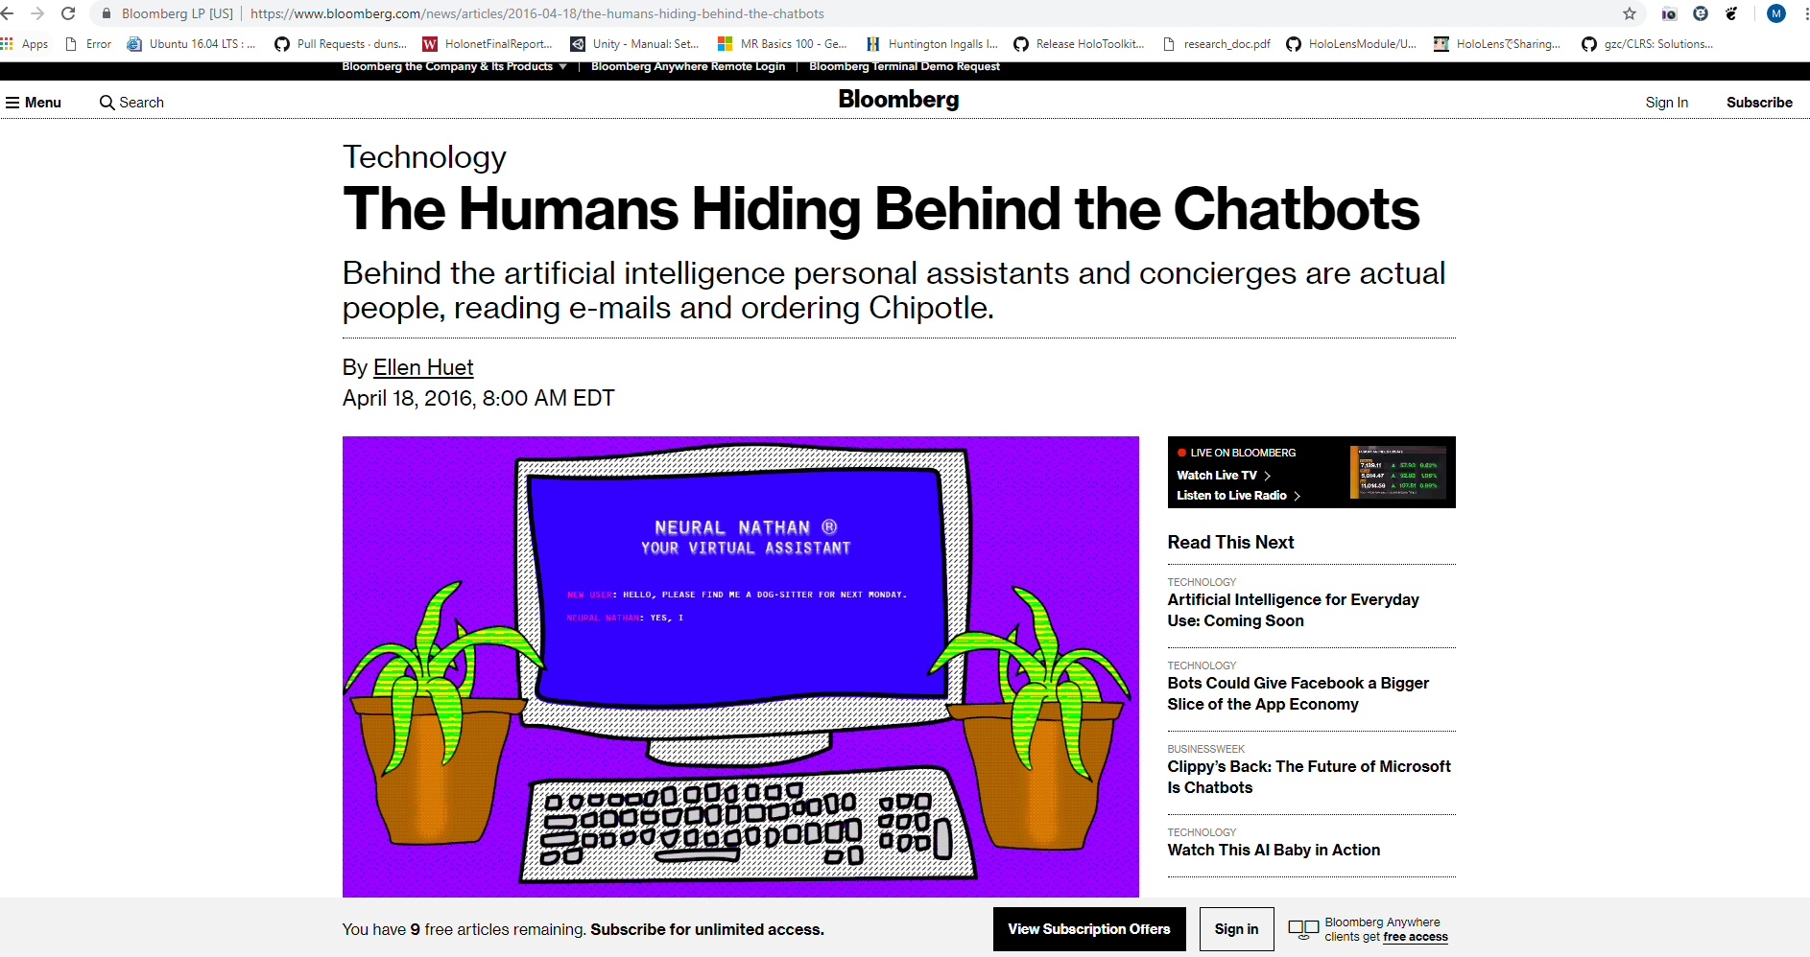
Source: https://www.bloomberg.com/news/articles/2016-04-18/the-humans-hiding-behind-the-chatbots

Slide 25
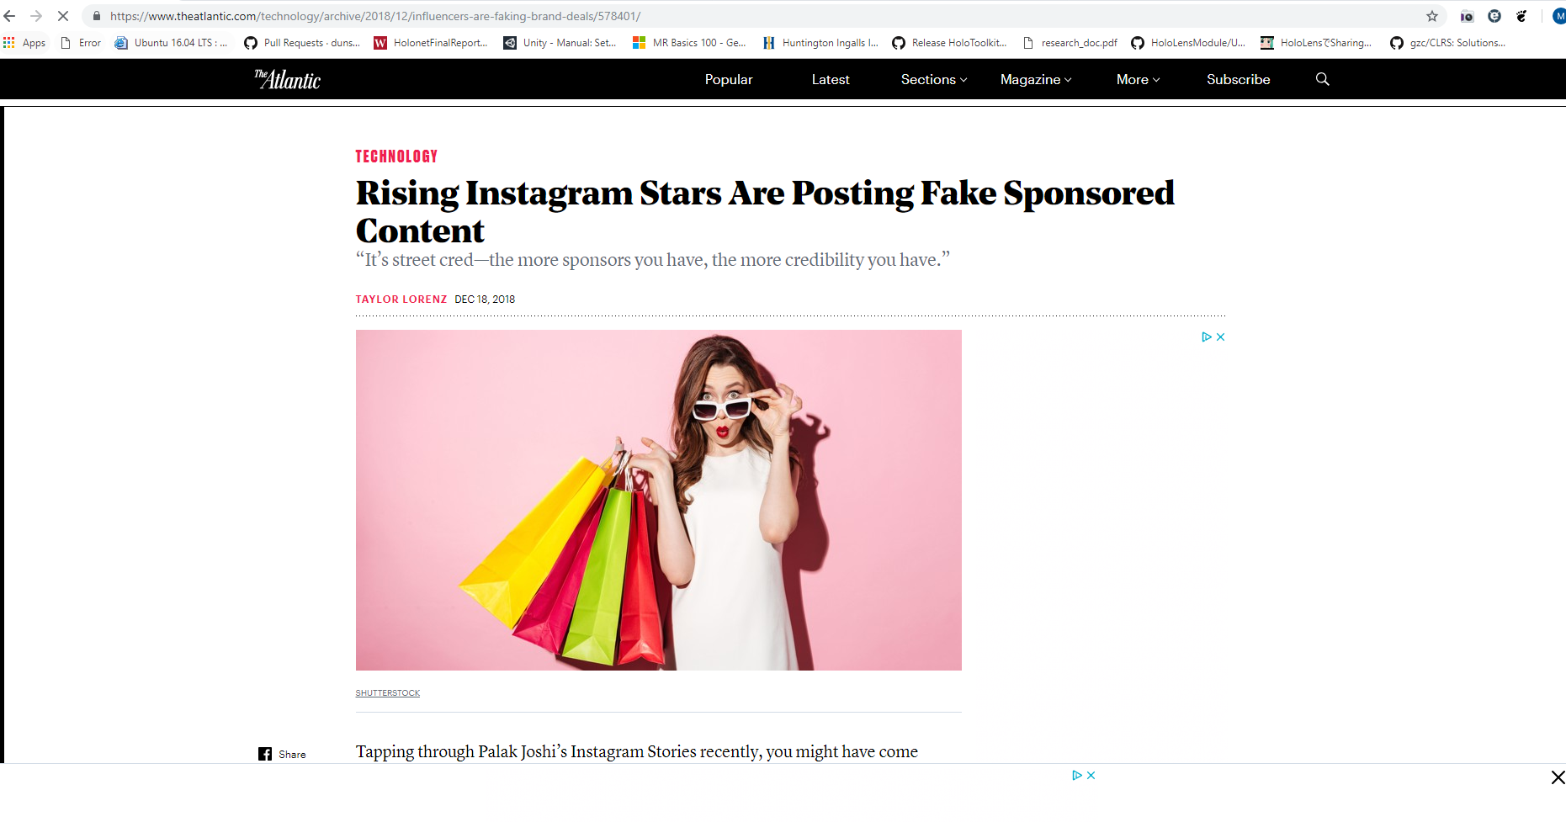
Source: https://www.theatlantic.com/technology/archive/2018/12/influencers-are-faking-brand-deals/578401/

Slide 26
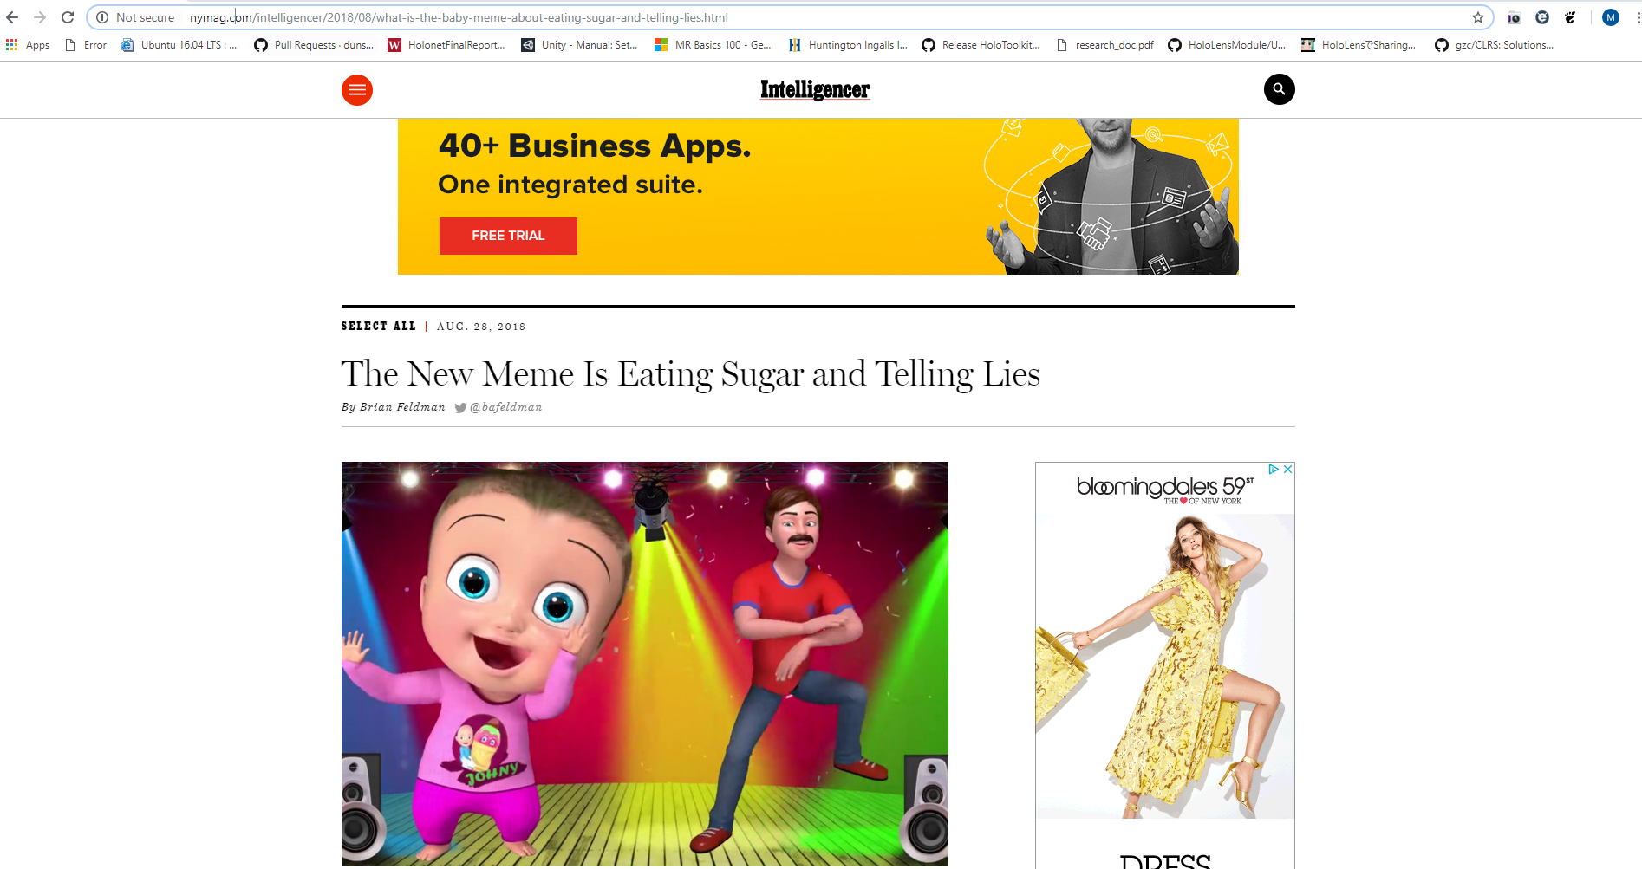
Source: http://nymag.com/intelligencer/2018/08/what-is-the-baby-meme-about-eating-sugar-and-telling-lies.html

Slide 27
Houston we have a problem…
Botnets make it overwhelmingly difficult to determine real vs fake
All data traffic is saturated and does not reflect true human traffic
Businesses are fake
Content is fake
Politics are fake
Are we real?
Source: http://nymag.com/intelligencer/2018/12/how-much-of-the-internet-is-fake.html

Slide 28
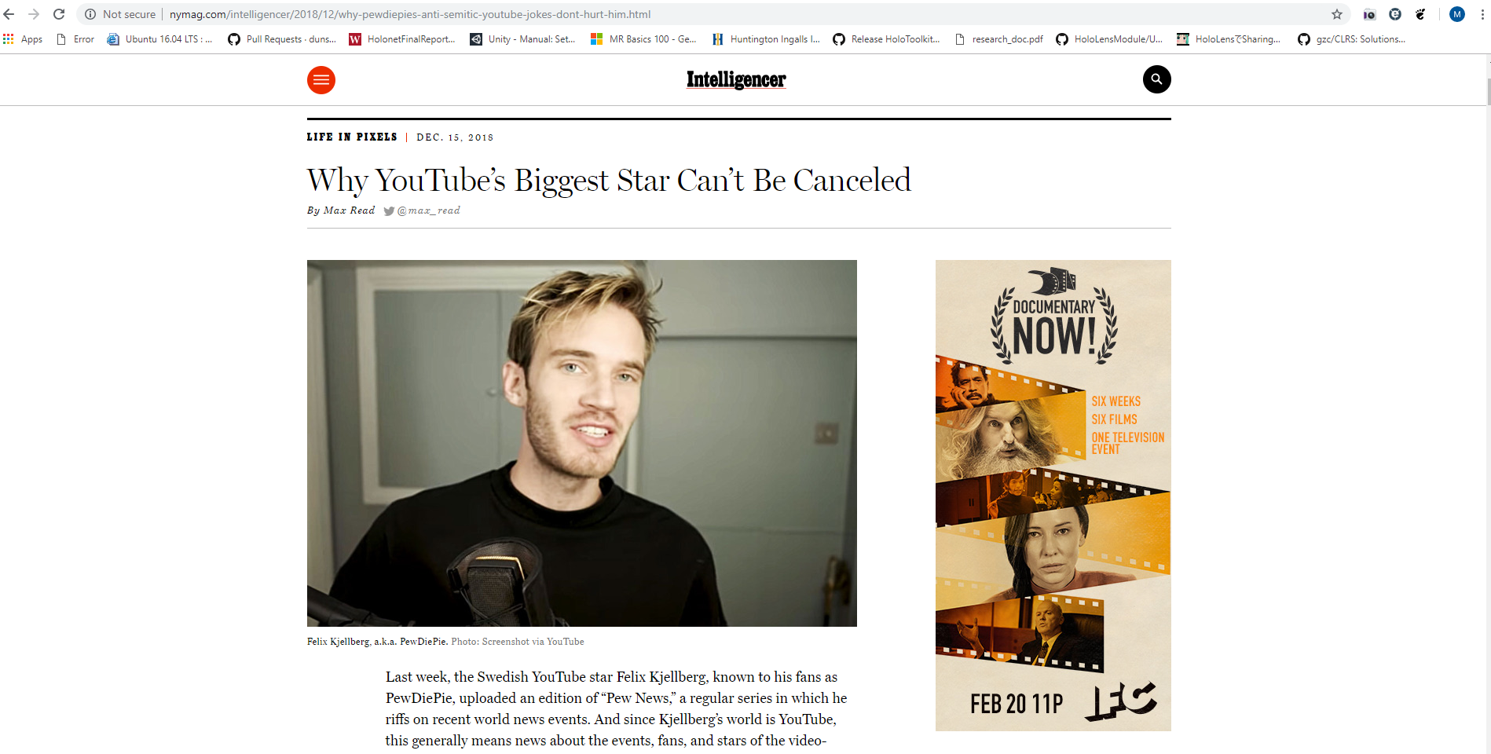
PewDiePie?
Source: http://nymag.com/intelligencer/2018/12/why-pewdiepies-anti-semitic-youtube-jokes-dont-hurt-him.html

Slide 29
Real is being outsourced
We now have to prove that we are “not a robot”

Slide 30
Closing Remarks
JavaScript is bad. Botnets are bad.

